Slide 1
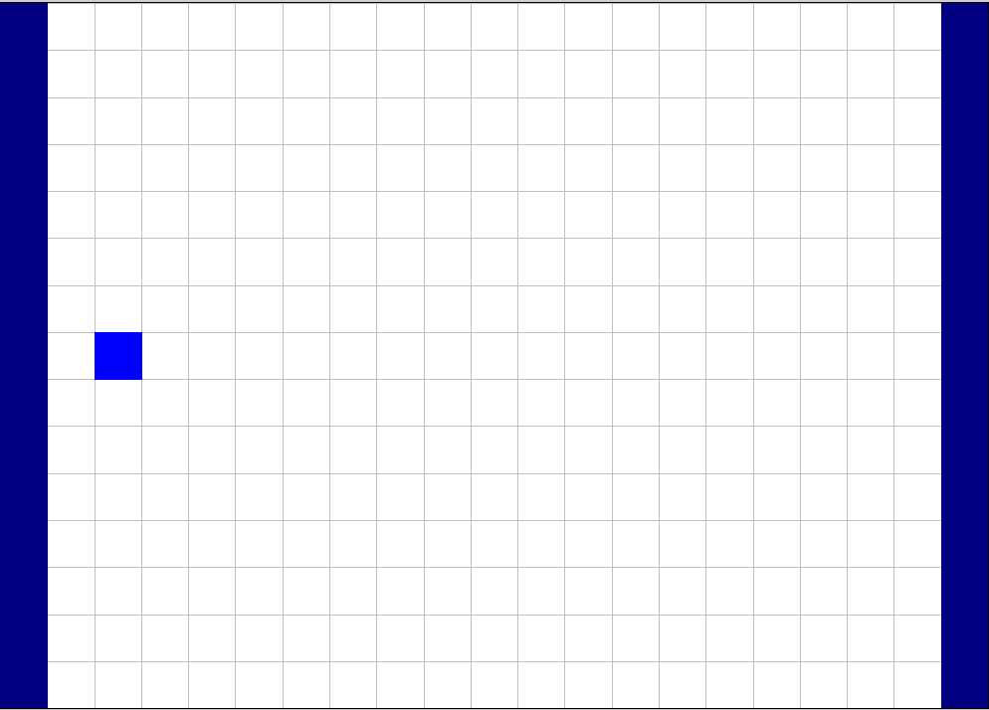
ModFlow/MT3DMS 3d transport
15 rows, 21 columns, 8 layers; grid spacing 10 m
Effective porosity: 0.2
Hydraulic conductivity: 1.0 m/day
Longitudinal dispersivity: 10 m
Ratio of horizontal transverse to longitudinal dispersivity: 0.3
Ratio of vertical transverse to longitudinal dispersivity: 0.3
Volumetric injection rate: 0.5 m3/day
Concentration of the injected water: 100 ppm
Darcy vol. flux: (80-60)/(10*20) * 1.0 = 0.1 m/day
Seepage linear velocity: 0.1/0.2 =0.5 m/day
80 m
7th layer
60 m
OBS #2
140 m
OBS #1
0.5 m3/day
OBS #3
Injection well: 8th row, 3rd column, 7th layer
Obs wells:
OBS #1: 8th row, 6th column, 7th layer
OBS #2: 11th row, 6th column, 7th layer
OBS #3: 5th row, 6th column, 7th layer
200 m

Slide 2
FEHM
(5,145,5)
Permeability: 1.157407e-12 m²
Injection rate:
0.5 m3/day = 500 kg/86400 s=
5.787037e-3 kg/s
0.78 MPa
0.58 MPa
(5,5,5)
(205,5,5)
Y
In Z-direction: (5,5,5) to (5,5,75)
X

Slide 3
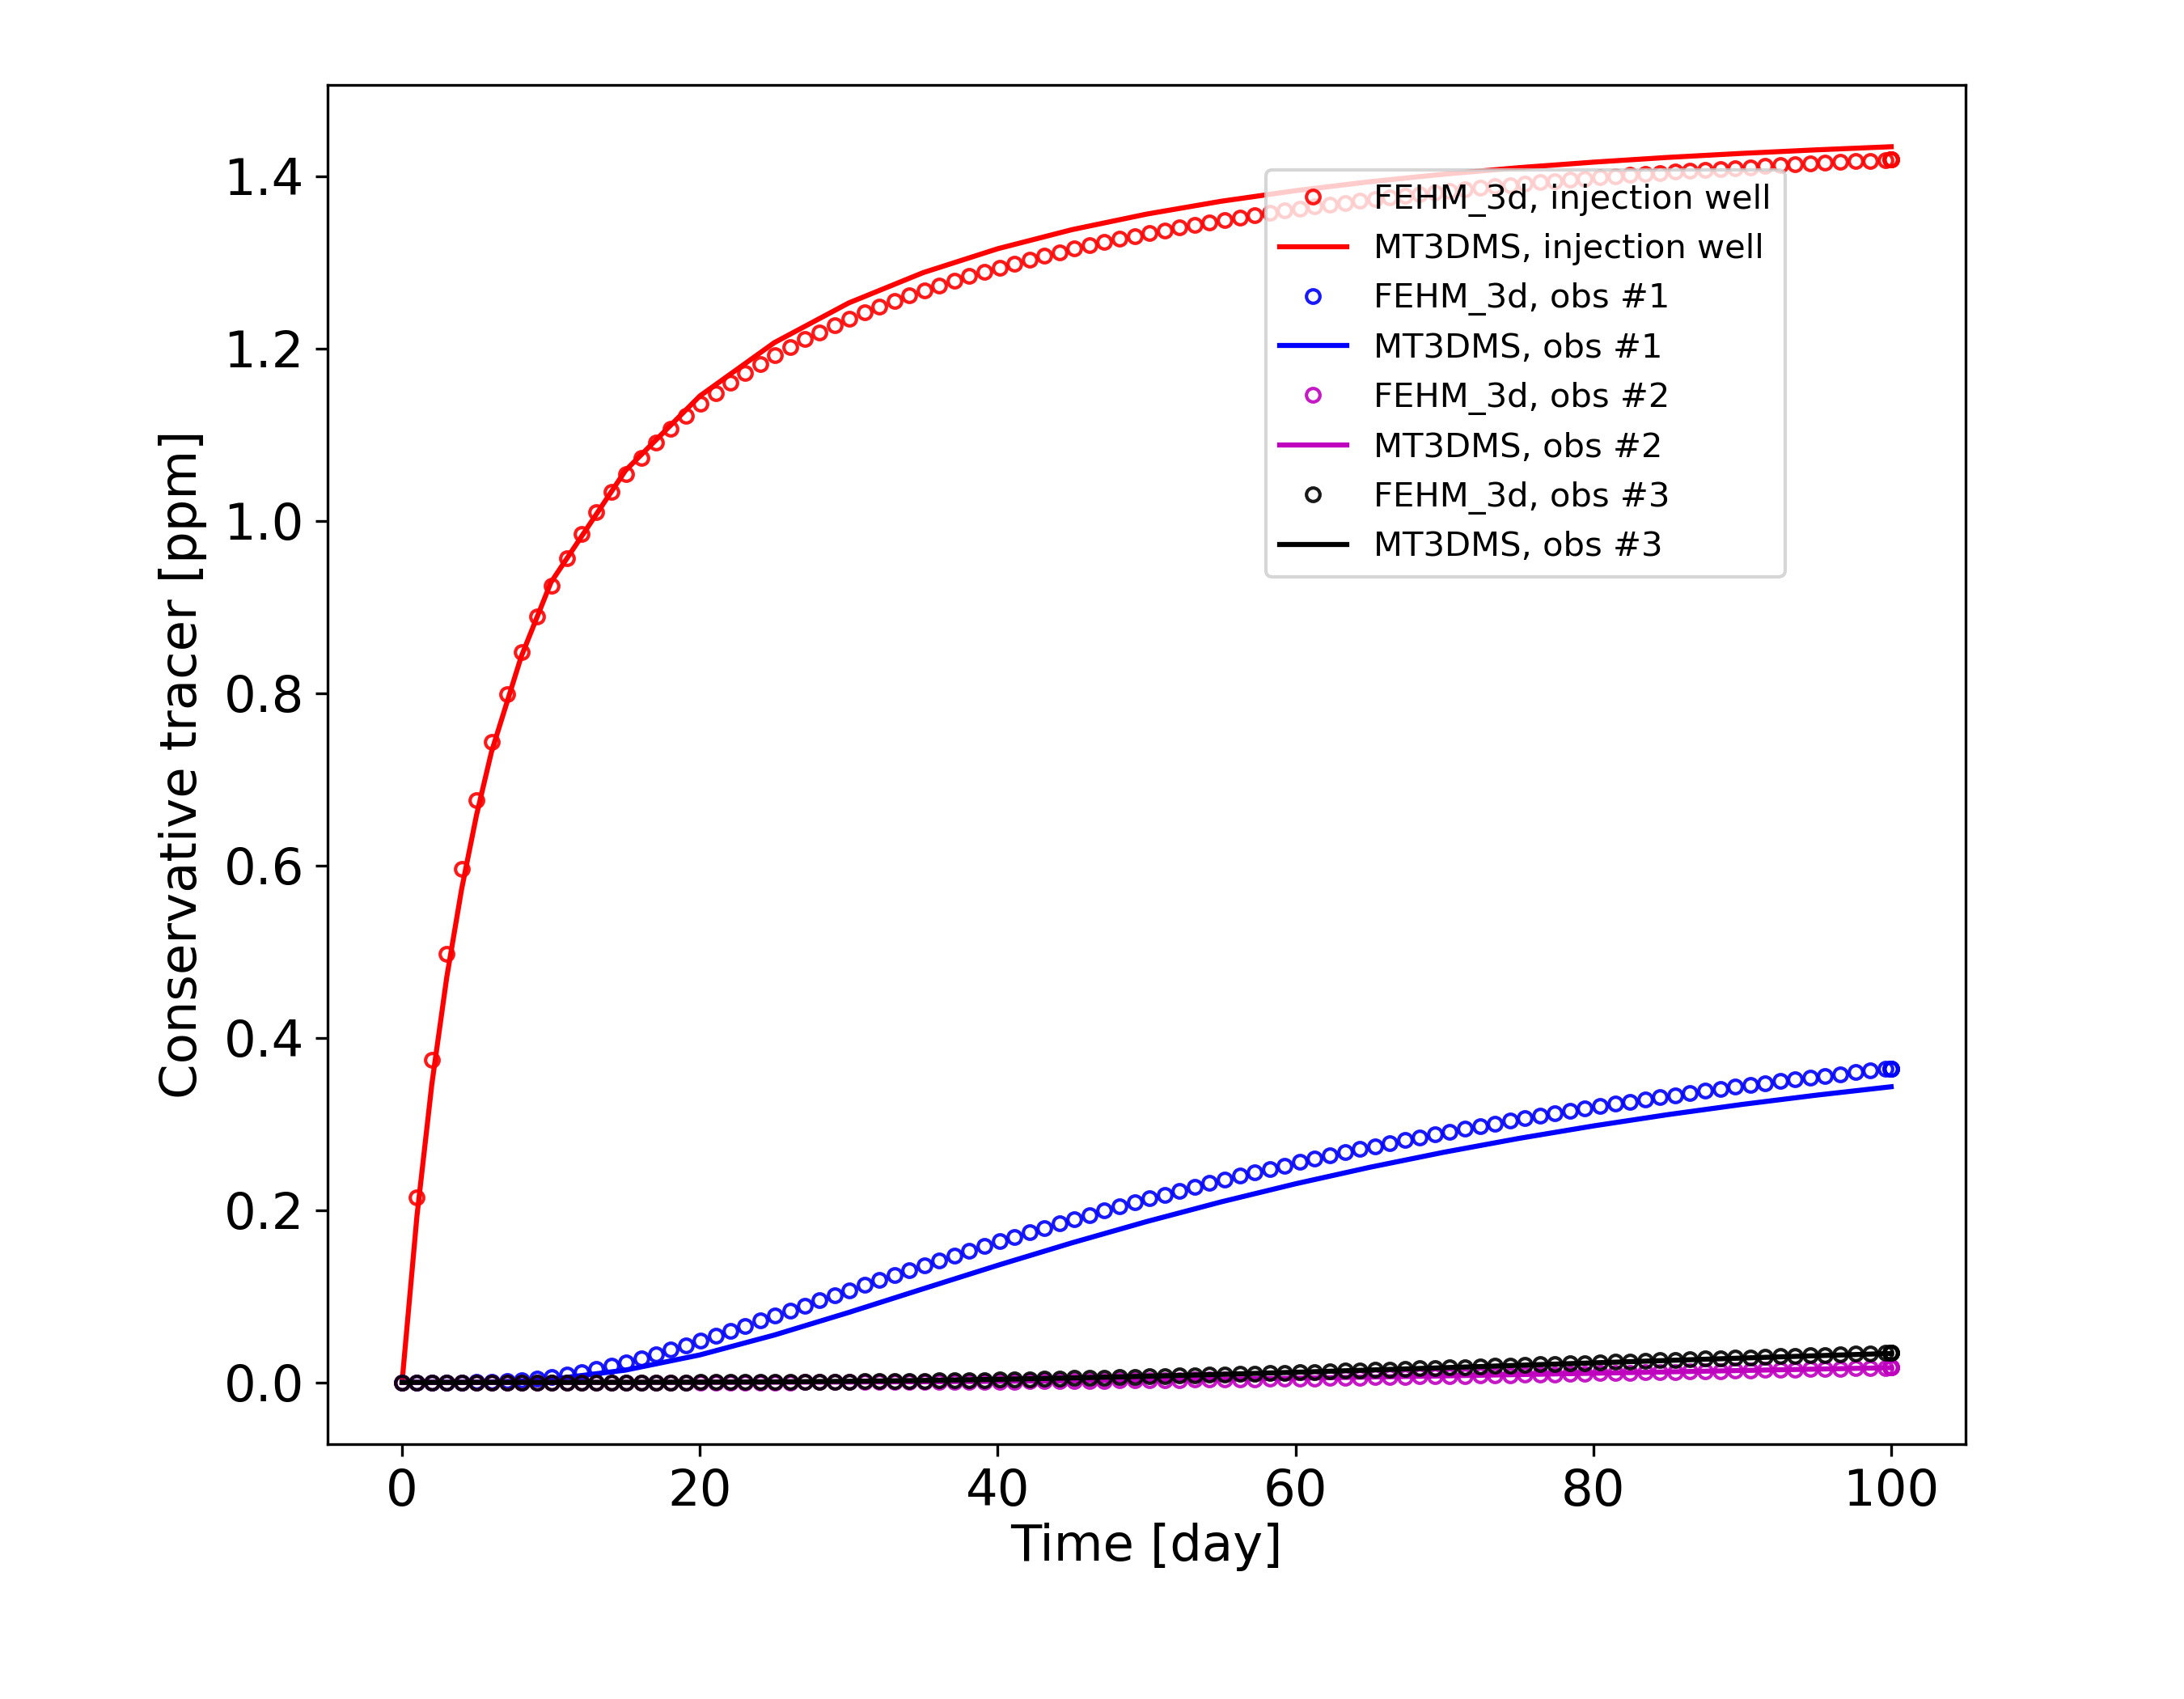
FEHM upstream weighting = 1.0
Finer mesh (1layer/column/row to 2 layers/columns/rows)

Slide 4

FEHM upstream weighting = 0.85
Finer mesh (1layer/column/row to 2 layers/columns/rows)

Slide 5
Finer mesh (1layer/column/row to 2 layers/columns/rows)
80 m
7th layer
60 m
OBS #2
140 m
OBS #1
0.5 m3/day
OBS #3
200 m
Notes:
27.5, 77.5, 67.5
57.5, 107.5, 67.5
57.5, 77.5, 67.5
57.5, 47.5, 67.5

